Slide 1




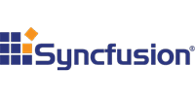


Northern VA CodeCamp Fall 2016
is sponsored by

Slide 2
HTTPS and TLS Landscape
NOVA CodeCamp 2016

Slide 3
About Me
Security Lead at Upside Travel
Site: https://vcsjones.com
Twitter: @vcsjones
https://github.com/vcsjones/Presentations

Slide 4
Background
HTTPS is designed to encrypt and authenticate a browser session.
Underlying protocol of choice is TLS.
Fast changes in HTTPS and TLS started around 2012.
Changes mean things invariably break.

Slide 5
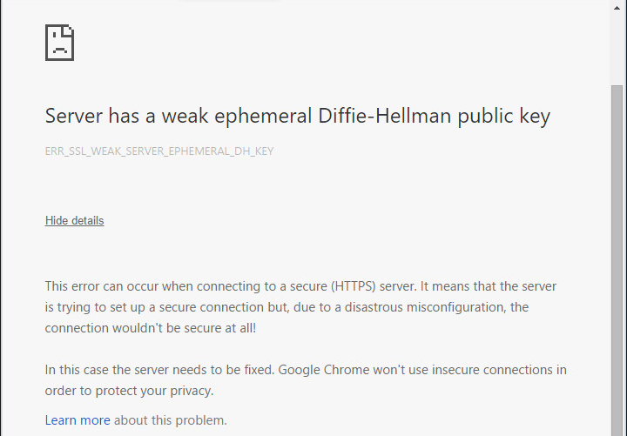
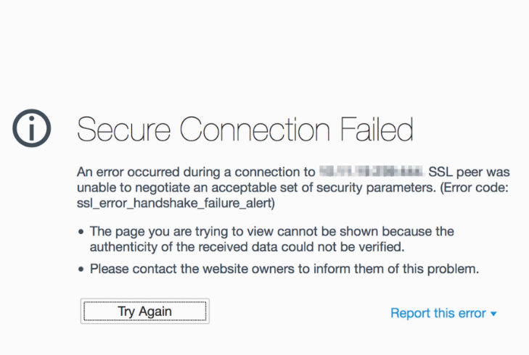

Slide 6
What Happened?

Slide 7
Changes.

Slide 8
Handshakes
HTTPS does a “handshake”.
Client and Server agree on capabilities.
Designed to be extendable and future proof.

Slide 9
Client Hello
Hello I’m a client!
Here’s the maximum version of SSL/TLS I support!
Here’s the cipher suites I support!
Here’s some extensions!

Slide 10
Server Hello
Great! I see you you support up to TLS 1.2, but I only support 1.0. Can we use TLS 1.0?
Thanks for the cipher suite list. Here’s the one I want to use.
I’ll wait for you to say we’re going to start encrypting now.

Slide 11
In practice, things go horribly wrong
Client: I support up to TLS 1.2.
Server: agggghhhh I don’t know what TLS 1.2 is! GOODBYE.
Client: But… up to TLS 1.2. You could have picked 1.0!
Sever: I SAID GOOD DAY.

Slide 12
Fallbacks
If a client fails a TLS handshake, it will try the handshake again.
It will lie about it’s maximum TLS version in order to appease the server.
Browser have a lot of work arounds to handle problems like this.

Slide 13
Fallbacks
Browser: I support TLS 1.0, TLS 1.1, and TLS 1.2.
Server: AGGGHHHH go away.
Browser: Uh, OK. I only support TLS 1.0 (fingers crossed).
Server: Oh, ok. Great! Let’s use TLS 1.0!

Slide 14
Broken HTTPS
SSL2 is completely broken.
SSL3 is broken enough that using it is considered a risk.
TLS 1.0 & 1.1 have problems.
TLS 1.2 have some minor problems but best we have.
TLS 1.3 on its way.

Slide 15
Fallbacks and Broken TLS
An active attacker could force a fallback.
They could force the browser to fallback to weaker versions of TLS.
Problem was widespread enough that Chrome ripped out fallbacks.
Other browsers support a signal called Fallback SCSV.

Slide 16
A fallback problem
The browser refuses to fall back to broken TLS version. - or -
Server may reject a client connection saying the browser shouldn’t have had to fallback.

Slide 17
Fallbacks Getting Better
Most servers properly negotiate
“Intolerance” checking has shown that some servers still special-case version selection.
TLS 1.3 is going to do things differently to avoid that.

Slide 18
Getting rid of TLS 1.0 & 1.1
PCI council took a hard stand to get rid of TLS 1.0 and 1.1 for payment applications.
TLS 1.2 came out in 2012.
Many Point-of-Sale terminals don’t support TLS 1.2.
Requirement delayed from July 2016 to July 2018.

Slide 19
What’s Next?
Cipher suite
A group of different crypto primitives that make TLS work
Not quite mix and match
Some offer strong encryption, some are broken

Slide 20
TLS_ECDSA_ECDHE_AES128_SHA256
Key exchange algorithm
Master secret hash algorithm / MAC algorithm
Signature algorithm
Symmetric encryption algorithm

Slide 21
Not all suites are equal
Ongoing research has shown many primitives used in cipher suites have flaws
RC4 has a bias
MD5 can produce collisions
CBC has padding oracle problems

Slide 22
Ongoing deprecations: RC4
RC4 is a symmetric encryption cipher
Widely deployed and a few desirable characteristics
Broken.

Slide 23
Ongoing deprecations: 3DES
3DES is already considered weak in contrast to AES
64-bit block size is problematic
Browsers want to remove it

Slide 24
Ongoing deprecations: CBC
AES is is considered secure but has a lot of problems with “CBC” mode.
Mode of choice is GCM.
GCM does not require padding (like RC4).

Slide 25
Ongoing deprecations: SHA1
Using SHA1 for authentication is largely considered weak
Prefer SHA256 or SHA384

Slide 26
What’s left?
Lots of fear about “too many eggs in the AES basket”.
AES+GCM is really the only thing left
CHACHA gaining traction to provide some diversity
Same with x25519
EcDSA maybe?

Slide 27
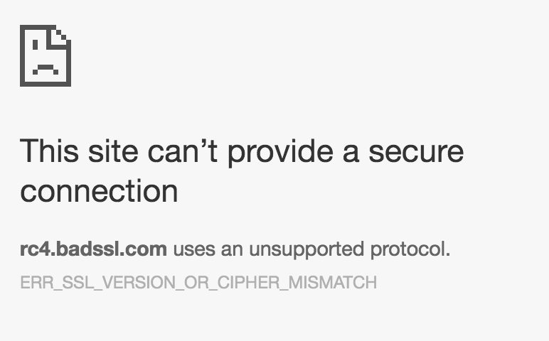
Cipher Suite Mismatch
When no cipher suite can be agreed upon.

Slide 28
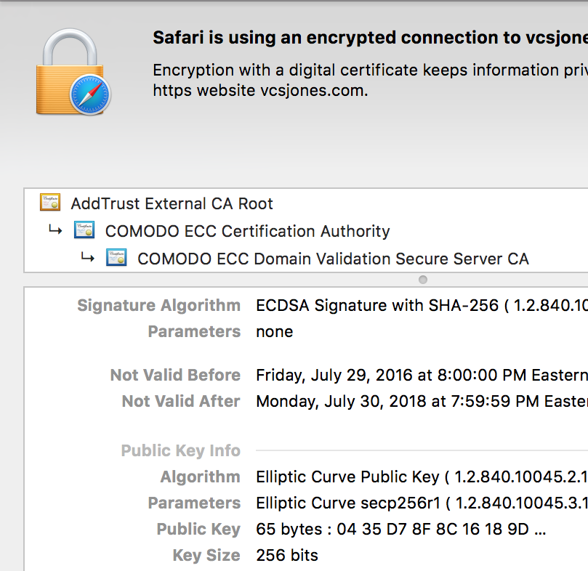
What about certificates?
Most attention comes to the certificate
CA/B forbids SHA1 issuance
CA/B is governing body of certificate issuance

Slide 29
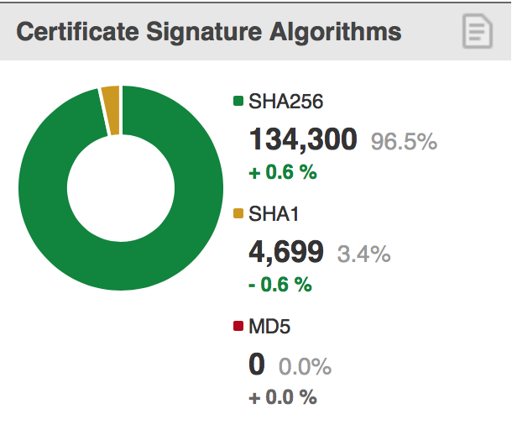
SHA-2 certificates
Easy enough for browsers to handle
Difficulties with embedded devices (Point of Sale, ATMs)
Difficulties with chains (issuer of the certificate) being all SHA2
Browser UX for certs expiring after 2016 in SHA1

Slide 30
Key Exchanges
Elliptic Curve Diffie-Hellman (ECDHE) is last remaining one
Chrome / Firefox require 2048-bit DHE after “Logjam”
Apple / Chrome eventually removed DHE all together
New Hope is an experiment performed by Google
Fun fact: “little” New Hope is called JarJar
Experiment for quantum cryptography

Slide 31
What does all this mean for me?
Server operators are being forced to turn off old, broken things.
Discovery of brokenness accelerated in 2012.
Software needs to support what servers support.

Slide 32
Next Generation
HTTP/2 in practice requires HTTPS
Apple requires HTTPS for application developers (ATS)
Must support TLS 1.2
Only strong cipher suites supported
Chrome advancing some HTML5 as HTTPS only
Geolocation
AppCache

Slide 33
What about .NET?
.NET 4.5 and below does not support TLS 1.2 by default as a client.
TLS 1.2 enabled by default in 4.6.
Best option: install 4.6.

Slide 34
Other options:
4.5 can set it during application startup (per AppDomain): ServicePointManager.SecurityProtocol = SecurityProtocolType.Tls12 Or use SchUseStrongCrypto in the registry (has other affects)
3.5- does not support it at all. Upgrade!

Slide 35
What about my server?
Windows is somewhat difficult to configure IIS ciphers
Affects the whole operating system: RDP, SQL, IIS…
Consider terminating TLS with nginx, haproxy, etc.

Slide 36
Why do I have customers demanding TLS 1.2?
PCI DSS (payment card industry) demands TLS 1.2 transition in 2018.
Apple ATS
Other developers are increasingly wary of TLS 1.0 and 1.1.
Other regulating standards and councils pushing forward.

Slide 37
What’s next?
TLS 1.3 is on the way. Firefox nightly supports a draft.
Cloudflare servers support a draft.
Very different from TLS 1.2. More like TLS 2.0.
Tries to address version intolerance by advertising it as an extension (Some servers don’t like unknown extensions, but is rarer)

Slide 38
Resources
https://ssllabs.com
Test your server
Test your client
Bulletproof SSL & TLS
Mozilla MDN
CA/B Baseline Requirements

Slide 39
Questions?

